Slide 1
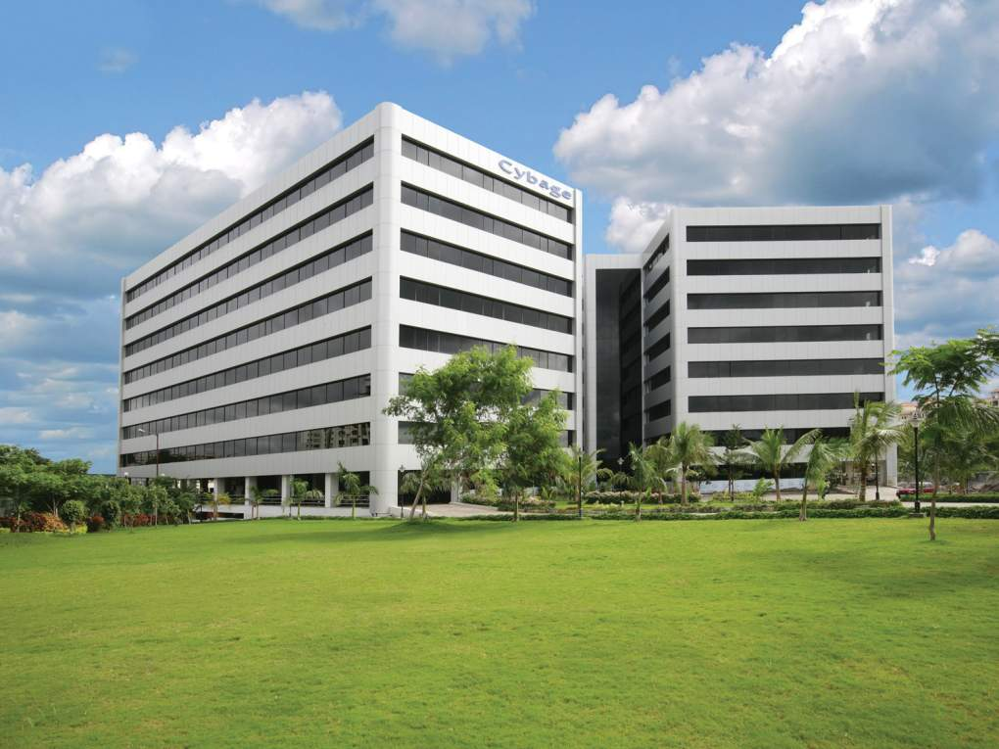
Build Tools : Apache Maven
Authored and Presented by: Neha Saini
This document and all its contents contain information from Cybage Software Private Limited which may be privileged, confidential, or otherwise protected from disclosure. The information is intended to be for the addressee(s) only. Any unauthorized disclosure, copy, distribution, or use of the contents of this message is strictly prohibited.

Slide 2
Agenda
Basics of build Tool
Why Apache Maven?
Maven Vs Ant
Maven Conventions
Maven Plugins
Maven Build Lifecycle
The Project Object Model (POM)
Maven repositories and workflow
Maven features
Demo

Slide 3
Basics of build Tool
• Build automation used to build deployable artifacts from source code.
Build tools are used for Build Automation.
1. compiling source code into binary code
2. packaging binary code
3. running tests
4. deployment to production systems
5. creating documentation and/or release notes

Slide 4



Build Tools
Various build tools available(Naming only few):
For java - Ant,Maven,Gradle.
For .NET framework - NAnt
c# - MsBuild.

Slide 5

What is Maven
Maven is a software project management tool.
It is a build tool or we can say it is more than just a “build tool” (used to build deployable artifacts from source code)

Slide 6

Primary Goal Of Maven
Allow a developer to comprehend the
complete state of a development effort
in the shortest period of time possible.

Slide 7
Why Apache Maven?
Maven follows Convention over configuration principle.
Maven is declarative
Maven has standard build lifecycle
Maven has Large existing repository
Plugins enhance functionality and reusability
Integrating all the different tools -sonar,coverage,testcase
Automate build process which reduces manual risks
Maven forces you to have a standard directory structure
Maven helps for better
Dependency management
Release management
Scalability
Documentation and release notes
Notes:
Declarative - You don’t define custom tasks or script the build. Instead, you describe the project and configure the build.

Slide 8
Maven Vs Ant
Ant | Maven
Ant doesn't has formal conventions, so we need to provide information of the project structure in build.xml file. | Maven has a convention to place source code, compiled code etc. So we don't need to provide information about the project structure in pom.xml file.
Ant is procedural, you need to provide information about what to do and when to do through code. You need to provide order. | Maven is declarative, everything you define in the pom.xml file.
There is no life cycle in Ant. | There is life cycle in Maven.
It is a tool box. | It is a framework.
It is mainly a build tool. | It is mainly a project management tool.
The ant scripts are not reusable. | The maven plugins are reusable.
It is less preferred than Maven. | It is more preferred than Ant.

Slide 9
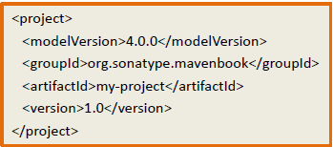
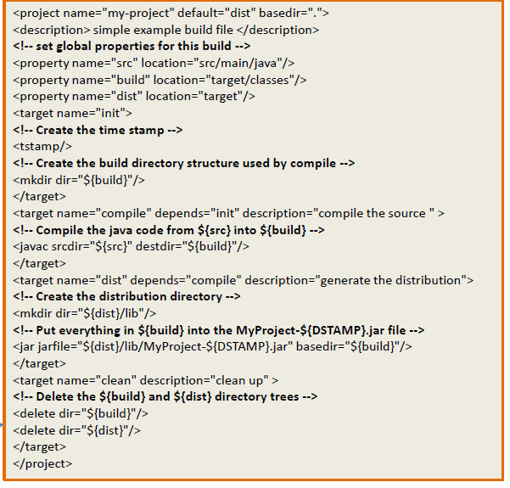



Maven Vs Ant

Slide 10
The Project Object Model (POM)
Projects are described through the use of a POM file.
Project Group(group ID), Name(artifactId) and Version
Artifact Type (project packaging)
Source Code Management
Dependencies
Plugins
Release Management
Profiles (Alternate build configurations)
Written in XML format

Slide 11
Basic pom.xml
<project>
<modelVersion>4.0.0</modelVersion>
<groupId>org.sonatype.mavenbook</groupId>
<artifactId>my-project</artifactId>
<version>1.0</version>
</project>
Version of Pom
Project group id
Name of project
Version of Project
Maven creates a SuperPom for every Maven project according to
it’s packaging type
• SuperPom acts as a parent and Pom acts as a child
• Pom inherits SuperPom and creates an EffectivePom
SuperPom + Pom = EffectivePom

Slide 12
Maven Conventions
Standard Artifact naming convention
What is an artifact?
All artifacts are uniquely identified by a set of Maven Coordinates
Group ID
Artifact ID
Version
Examples (group-id:artifact-id:version):
junit:junit:4.11

Slide 13
Maven Build Lifecycle
Maven is based on the central concept of a build lifecycle.
Build lifecycle is a pre-defined process of building and distributing an artifact (project).
Build lifecycles are broken down into build phases. Build phases are made up of goals.
Three build lifecycles
Clean - handles project cleaning
Default - handles building and deploying project
Site - handles generation of project documentation

Slide 14
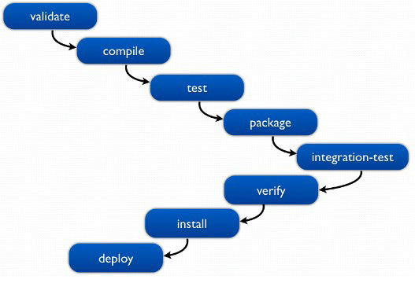
Build Phases for Default Lifecycle
Validate - Validate the project and check if all necessary information is available
Compile - Compile the source code of the project
Test - Test the compiled code using a suitable unit testing framework
Package - Package compiled code in its distributable format
Integration-test - Process and deploy the package (if necessary) to an environment where integration tests run
Verify - Run checks to verify the package validity and its quality
Install - Install the package into the local repository, which can be used as a dependency in other projects locally
Deploy - Done in an integration or release environment, copies the final package to the remote repository for sharing with other developers and projects
14
This list is not actually comprehensive, but is a list of the most important build phases. It also contains other pre and post phases. This lifecycle has total 23 phases

Slide 15
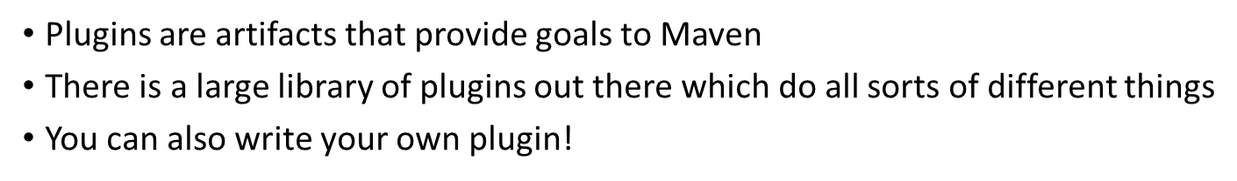
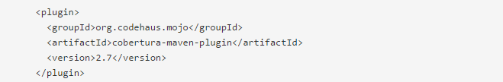
Plugins

Slide 16
Plugins
Build plugins | They execute during the build and should be configured in the <build/> element of pom.xml
Reporting plugins | They execute during the site generation and they should be configured in the <reporting/> element of the pom.xml

Slide 17
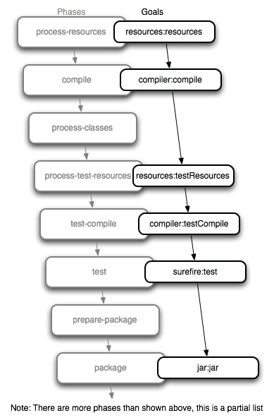
Phase Goal Relationship

Slide 18
Maven repositories and workflow
Repositories hold build artifacts of various types
Repositories can be local, central or remote
Local repository acts as a cache
Remote repositories are other repositories which are available or specified by user

Slide 19
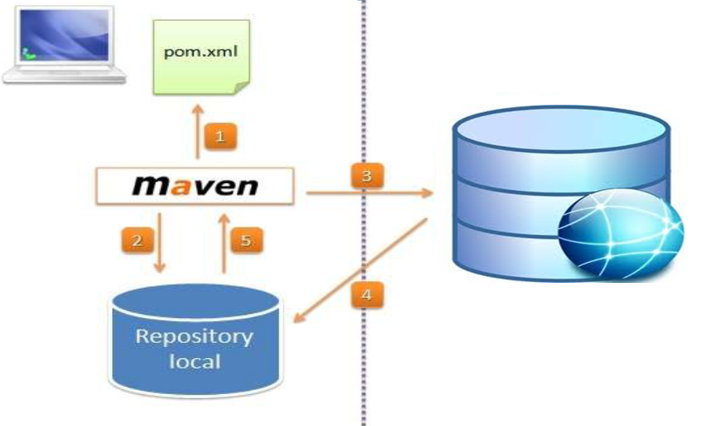
Repositories

Slide 20
Other Maven Features
Properties tag
Profiles
Archetypes
Transitive dependency resolution
Project Inheritance
Multi-Module Project

Slide 21
Properties tag
<properties> <spring.version>3.1.2.RELEASE</spring.version>
</properties>
<dependencies>
<dependency>
<groupId>org.springframework </groupId>
<artifactId>spring-core</artifactId>
<version>${spring.version}</version>
</dependency>
<dependency>
<groupId>org.springframework</groupId>
<artifactId>spring-context</artifactId>
<version>${spring.version}</version>
</dependency>
<dependencies>

Slide 22
Build Profiles
Profiles allow for the ability to customize a particular build for a particular environment; profiles enable portability between different build environments
A build's "portability" is a measure of how easy it is to take a particular project and build it in different environments
Using a build profile, you can customize build for different environments such as Production v/s Development environments
It provides Portability.

Slide 23
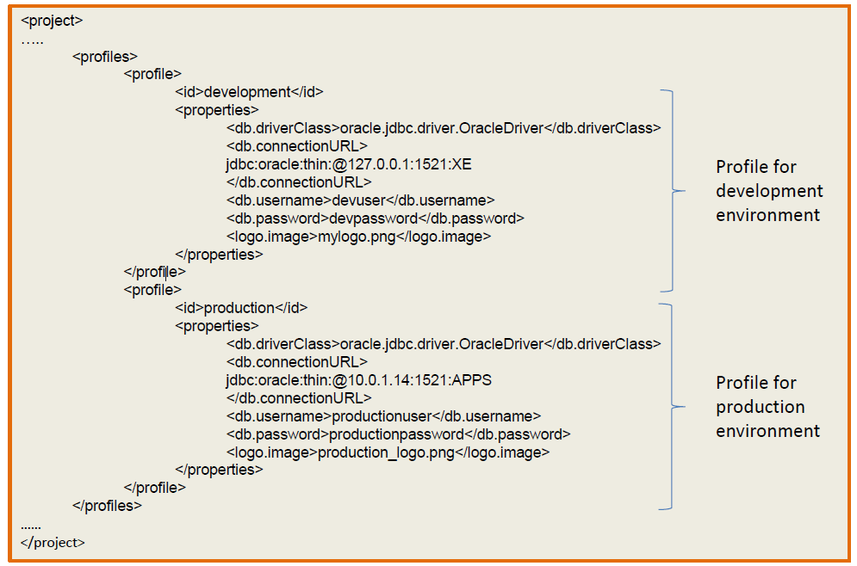
Build Profiles

Slide 24
Types of Build Profile
• Per Project - Defined in Project’s Pom itself. Applicable only at project level.
• Per User - Defined in the Maven-settings (%USER_HOME%/.m2/settings.xml).
Applicable on all Maven projects of a particular user
• Global - Defined in the Global Maven-settings (%M2_HOME%/conf/settings.xml).
Applicable on all Maven projects

Slide 25
Build Profile Activation
We can activate build profiles in following ways
• Explicitly using command prompt
• Through maven settings
• Based on Environment variable
• Based on Operating System
• Based on present and missing files
• Activate Default profile

Slide 26
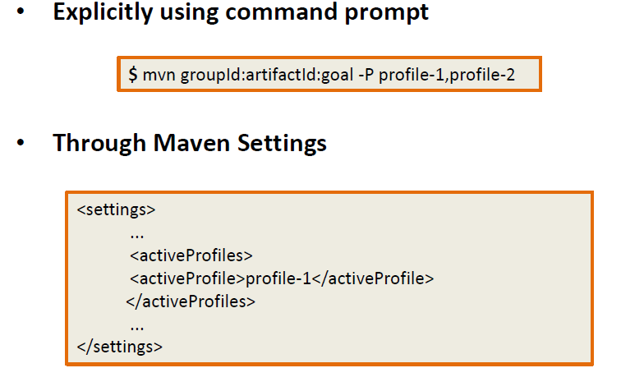
Build Profile Activation

Slide 27
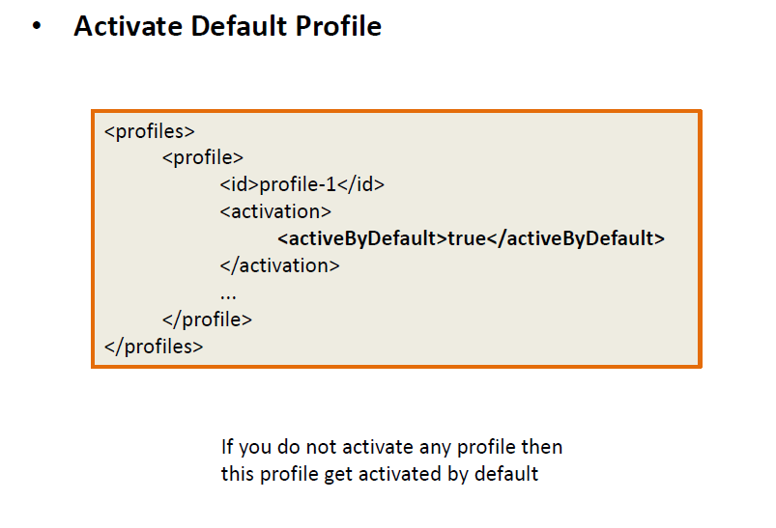
Build Profile Activation

Slide 28
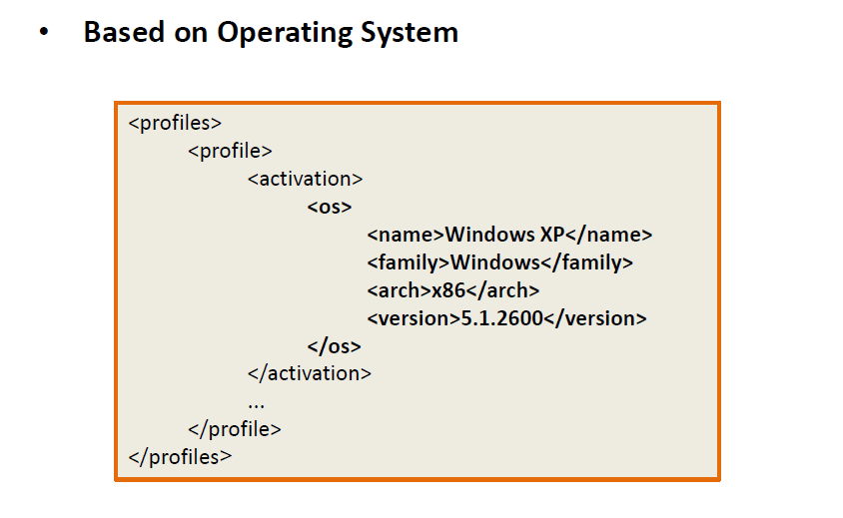
Build Profile Activation

Slide 29
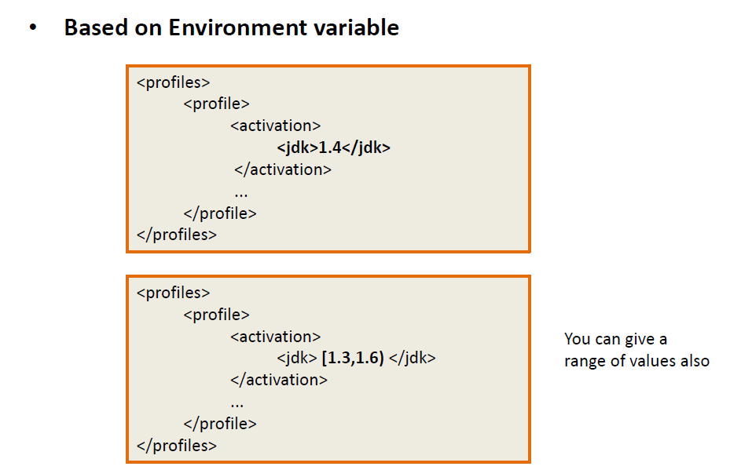
Build Profile Activation
Build Profile Activation

Slide 30
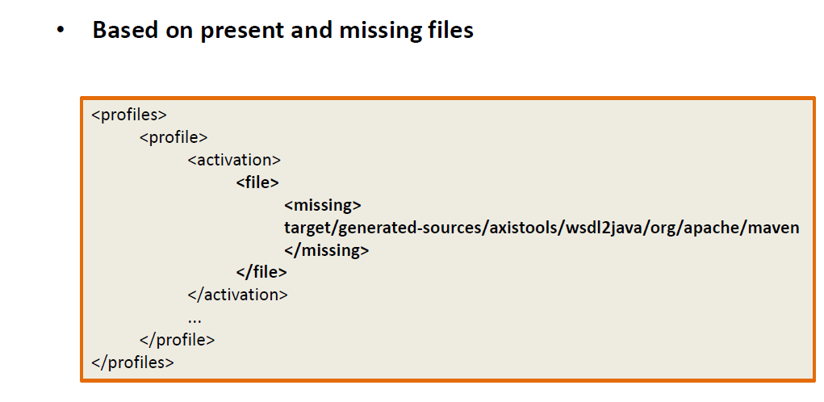
Build Profile Activation

Slide 31
Archetypes
• Archetype is a Maven plugin whose task is to create a project structure as per its template.
mvn archetype:generate -DgroupId=com.mycompany.app -DartifactId=my-app -DarchetypeArtifactId=maven-archetype-j2ee-simple -DinteractiveMode=false

Slide 32
Archetypes
Archetype ArtifactIds | Description
maven-archetype-archetype | An archetype to generate a sample archetype.
maven-archetype-j2ee-simple | An archetype to generate a simplifed sample J2EE application.
maven-archetype-plugin | An archetype to generate a sample Maven plugin.
maven-archetype-plugin-site | An archetype to generate a sample Maven plugin site.
maven-archetype-portlet | An archetype to generate a sample JSR-268 Portlet.
maven-archetype-quickstart | An archetype to generate a sample Maven project.
maven-archetype-simple | An archetype to generate a simple Maven project.
maven-archetype-site | An archetype to generate a sample Maven site which demonstrates some of the supported document types like APT, XDoc, and FML and demonstrates how to i18n your site.
maven-archetype-site-simple | An archetype to generate a sample Maven site.
maven-archetype-webapp | An archetype to generate a sample Maven Webapp project.

Slide 33
Transitive Dependency Resolution
Transitive dependencies are one of the features that make maven extremely powerful. As an example of a transitive dependency, suppose one project, called “A", is dependent on B, Now, suppose a second project, “C", is dependent on “A". This means that “C" is also dependent on the B. Maven can help us handle this situation automatically.
We only need to define direct dependency in each project pom. Maven handles the rest automatically

Slide 34
Transitive Dependency Resolution
• Transitive dependencies are controlled using:
–Exclusions
–Optional declarations
–Dependency management
–Dependency mediation

Slide 35
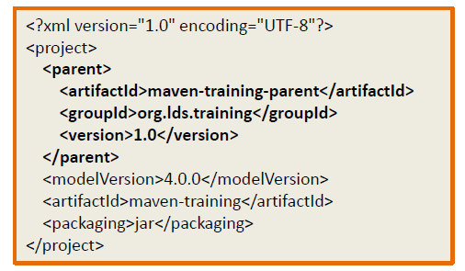
Project Inheritance
• Pom files can inherit configuration
– GroupId, version
– Project config
– Dependencies
– Plugin configuration
– Etc.

Slide 36
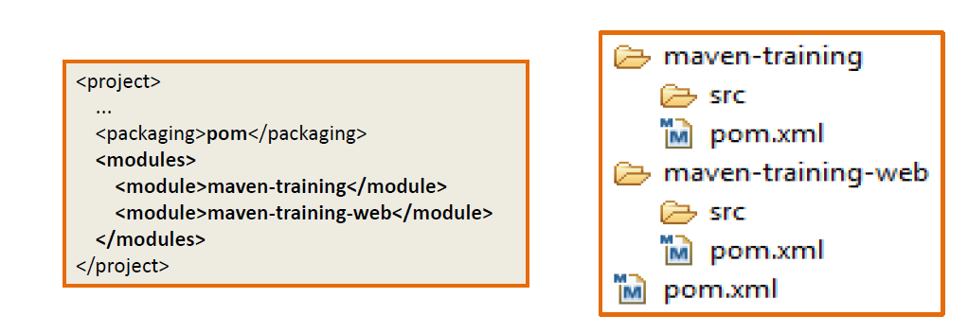
Multi-Module Projects
• Maven has 1st class multi-module support.

Slide 37
Maven Best Practices
Always specify a version for Maven2 plugins
Minimize number of SNASPHOT dependencies
Use dependency management section
Beware of relocation in maven repo
Minimize the number of Profiles
Use Properties Liberally

Slide 38
Maven - Environment Setup
http://www.tutorialspoint.com/maven/maven_environment_setup.htm

Slide 39
Maven - Environment Setup
Maven is Java based tool, so the very first requirement is to have JDK installed on your machine.
System Requirement
JDK | 1.5 or above.
Memory | no minimum requirement.
Disk Space | no minimum requirement.
Operating System | no minimum requirement.

Slide 40
References
https://maven.apache.org/
http://mvnrepository.com/
http://www.tutorialspoint.com/maven/

Slide 41

Any Questions?

Slide 42
Thank you!

